Slide 1
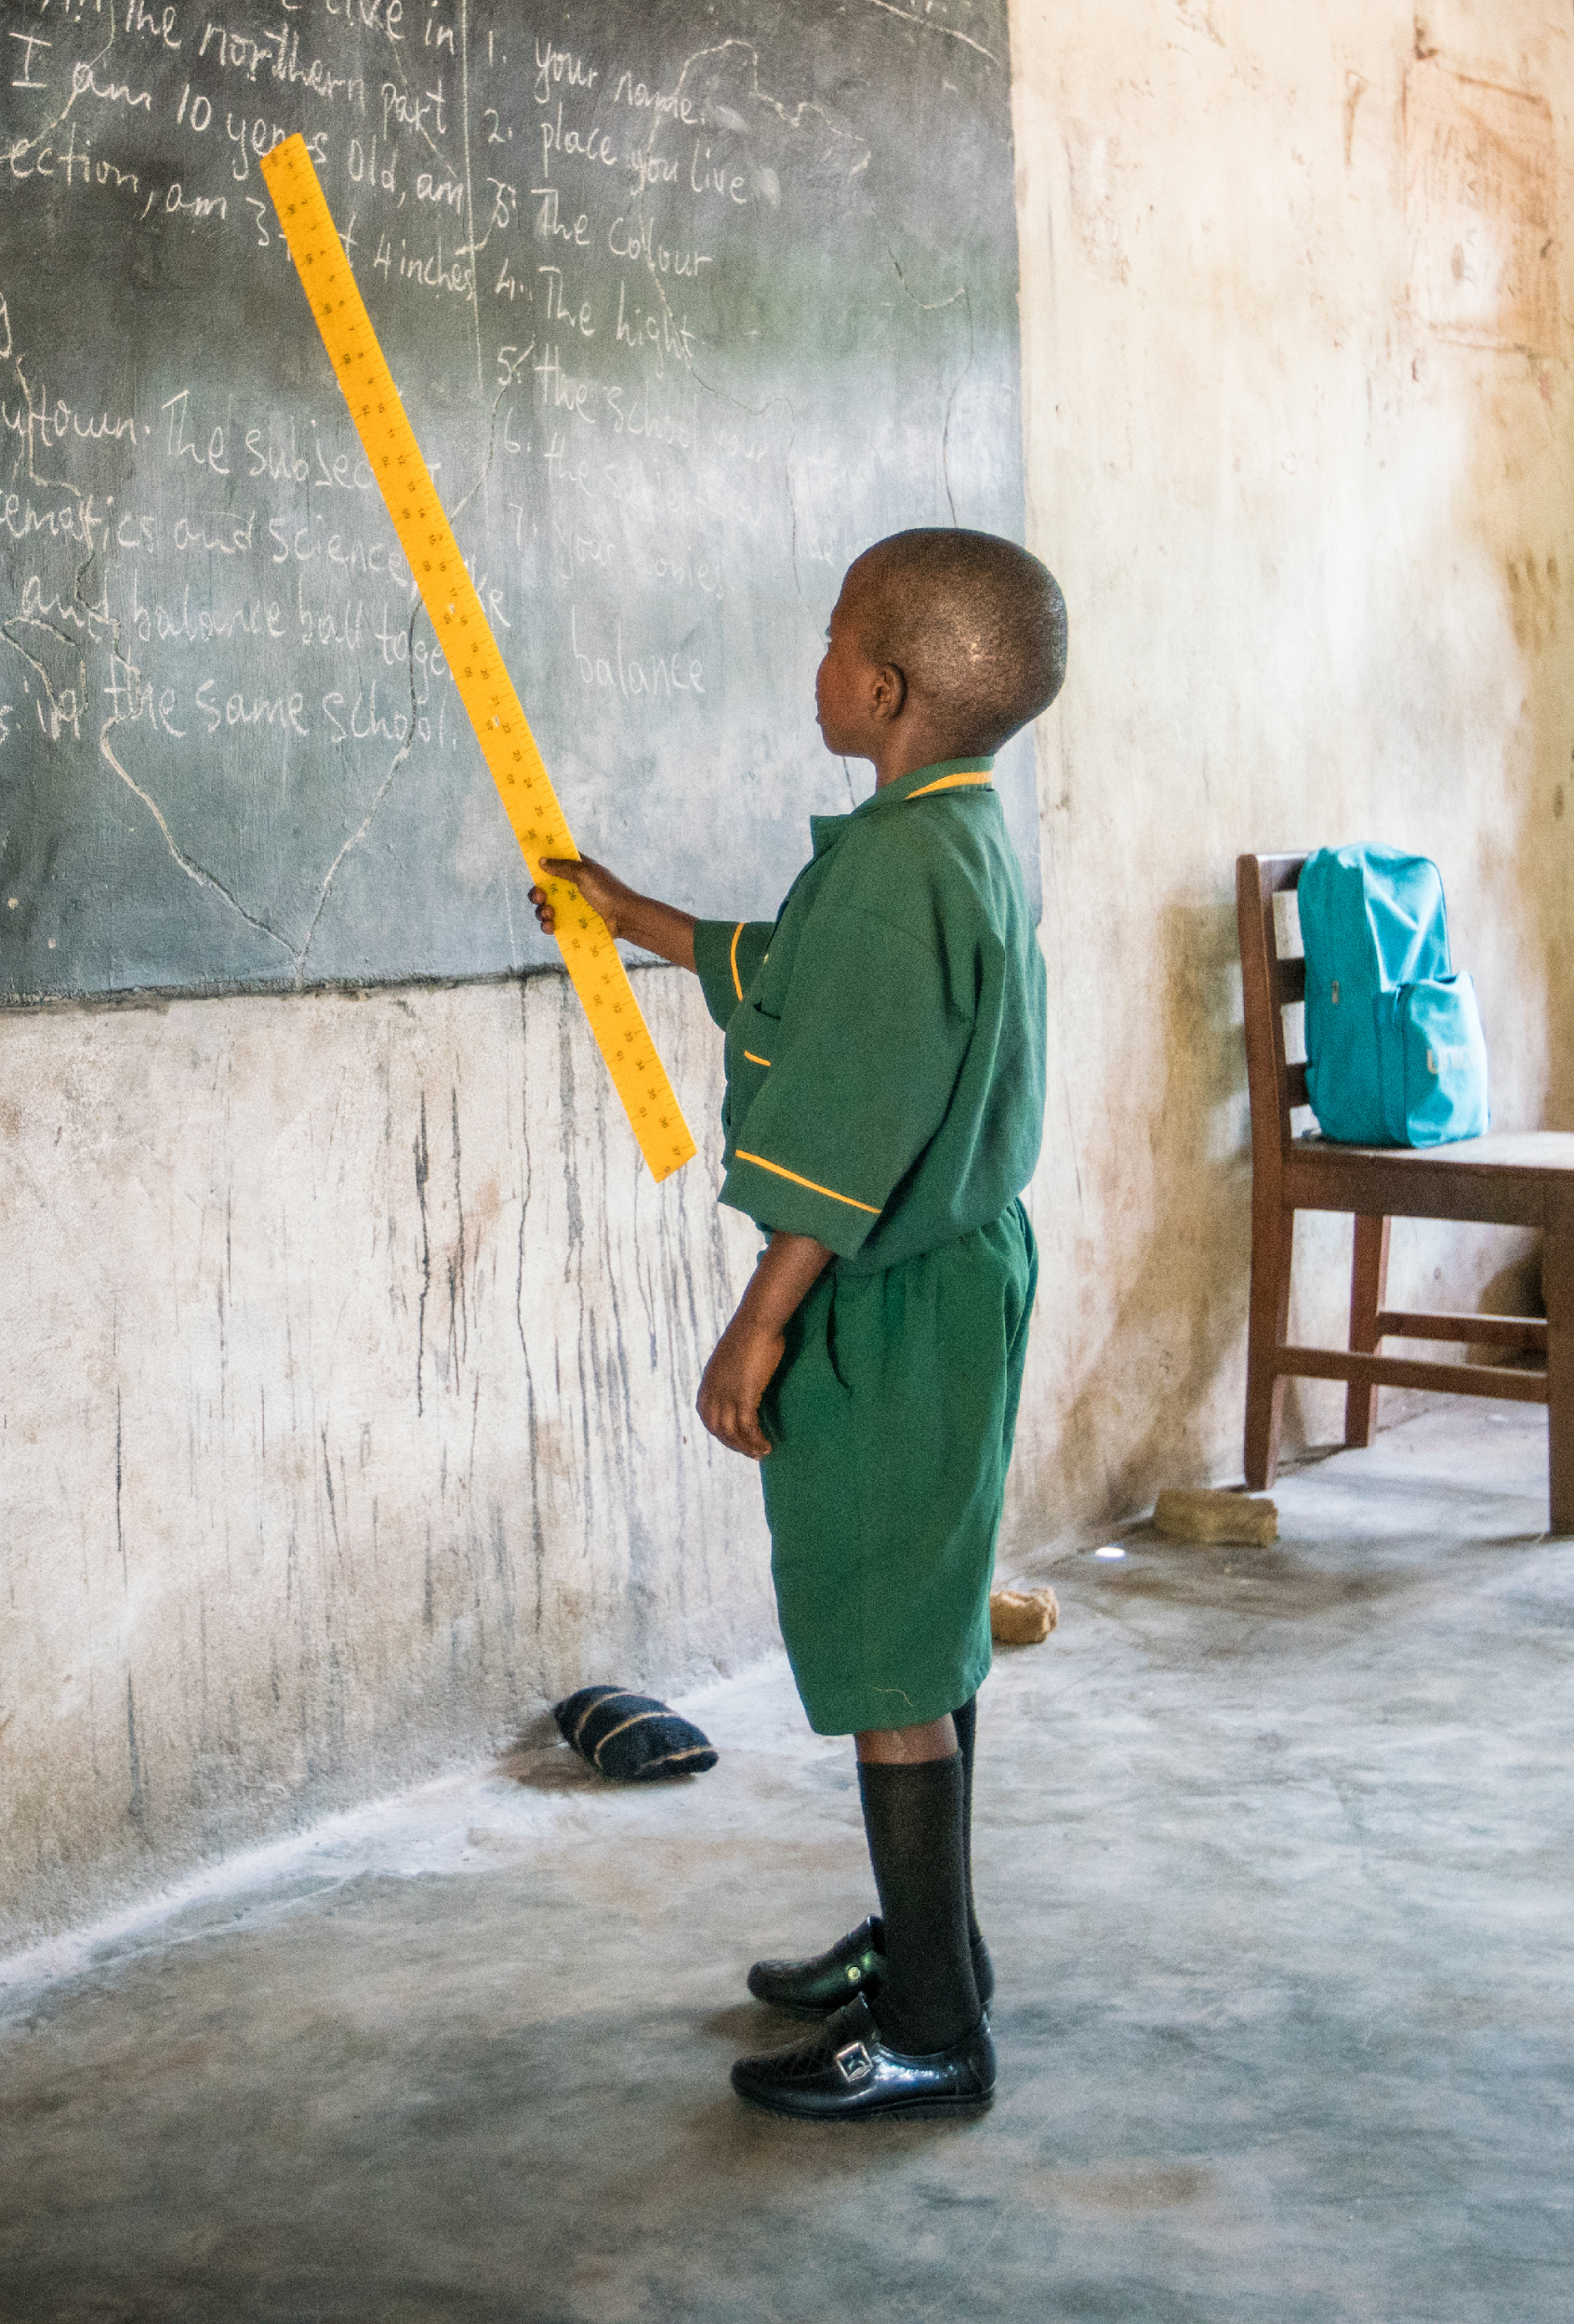
Inclusive education CBPR in West Africa May 2021
Gender and inclusive education
participatory research
in West Africa
June 2021

Slide 2
What is being asked?
Sierra Leone, Cameroon and Senegal: asking 300 boys and girls with disabilities, their parents and teachers, via focus group discussions, on:
What they experience as barriers to participation
What being included and excluded in daily life looks like for them
Their successes and challenges
Their ideas for change
How they are experiencing the interventions

Slide 3
Methodology
Community-based participatory research (CBPR) involves:
Committing to sharing power and resources
Working towards beneficial outcomes for all participants
Bringing unique strengths from all
Cameroon community researchers

Slide 4
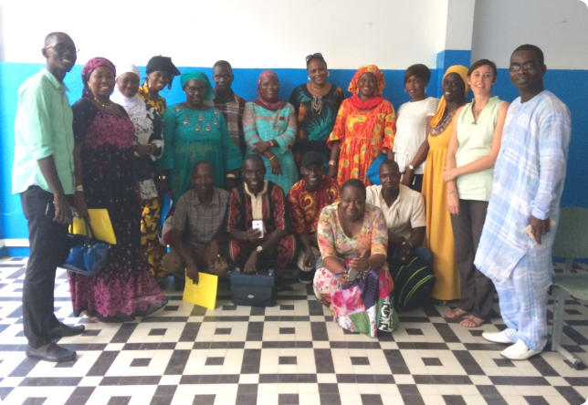
Data collection and analysis
300 participants
30 community researchers trained: teachers and parents, a third with disabilities
48 focus group discussions in 16 schools led by community researchers
3 phases of data collection
all involved in analysis
Senegal community researchers

Slide 5
School and classroom environment
Sierra Leone: girls described by teachers as ‘shy’ or ‘afraid to talk’. Boys: ‘stubborn’, ‘bold’ and ‘physically strong’. Sometimes girls seen as more capable academically than boys, also ‘troublesome’ (leaving without reason). Girls: in need of care and information around their menstrual cycle and related hygiene.
Senegal: some believed that girls learn faster than boys, others that it was more difficult for girls to cope with the challenges of education.
Cameroon: teachers felt girls more comfortable to tell teachers when struggling Girls expressed receiving help from friends. Boys seemed more reluctant to ask for help, more vulnerable to being left out of school activities. Disruptive behaviour - both boys and girls, incidents more frequent with boys.
Girls with visual impairments spoke of needing low vision devices. A few girls reported they had to give assistive device to a boy or theirs was stolen.

Slide 6
Peer relationships (boys and girls)
Sierra Leone: both boys and girls with disabilities reported suffering from intentional and unintentional unkindness. Girls tended to express being mocked for their handwriting, facial expressions or equipment they used. Boys were mocked for being slow in their work or how they moved or spoke.
Cameroon: both boys and girls with disabilities expressed fears and stories of violence and abuse from their schoolmates. Boys tended to report rough physical behaviour. Girls were more likely to talk about emotional abuse and there were also concerns about their safety in the dormitories.

Slide 7
Parental and community attitudes
Sierra Leone: despite equity of rights progress, discriminatory practices in relation to girls persist. Some parents believed daughters ‘no use’ and their education a ‘waste of money’. Several parents felt girls more stigmatised and preferred daughters to study at home. Through the project, some girls were given additional support in the community - in some instances it provoked resentment from boys and/or their parents.
Senegal: girls with visual impairments were perceived to be more reliant on others and ‘more attached to their parents’.
Cameroon: girls talked about sympathetic views in the community more than boys. Emotional difficulties reported by parents more frequently mentioned in relation to boys with disabilities.

Slide 8
Important ways forward
Gender and disability intersect in a complex way and the impact of both needs to be recognised at all stages of an education process, Stay present to complexity - avoid homogeny
Both disability and gender also intersect with social and cultural context - it is critical not to make assumptions about their impact on education; collecting context specific evidence is important.
There are factors that disadvantage both boys and girls with disabilities and need to be addressed eg. access to assistive devices, need for family support, transport to school, stigma.
Gender plays an important role in determining children’s engagement with education and needs to be taken into account in developing school curricula and school environment.

Slide 9
What does this research add to our programme / global knowledge?
Allows boys and girls with disabilities, their parents and teachers to shape the ongoing interventions in which they are involved.
Empowers community members to contribute and share expertise, decision-making and ownership
Enables teachers, directors and inspectors to draft disability and gender action plans

Slide 10
Thank you
For more information: Email: mgreenwood@sightsavers.org Visit: www.sightsavers.org
https://research.sightsavers.org/project/inclusive-primary-education-in-west-africa-through-a-gender-lens/

