Slide 1
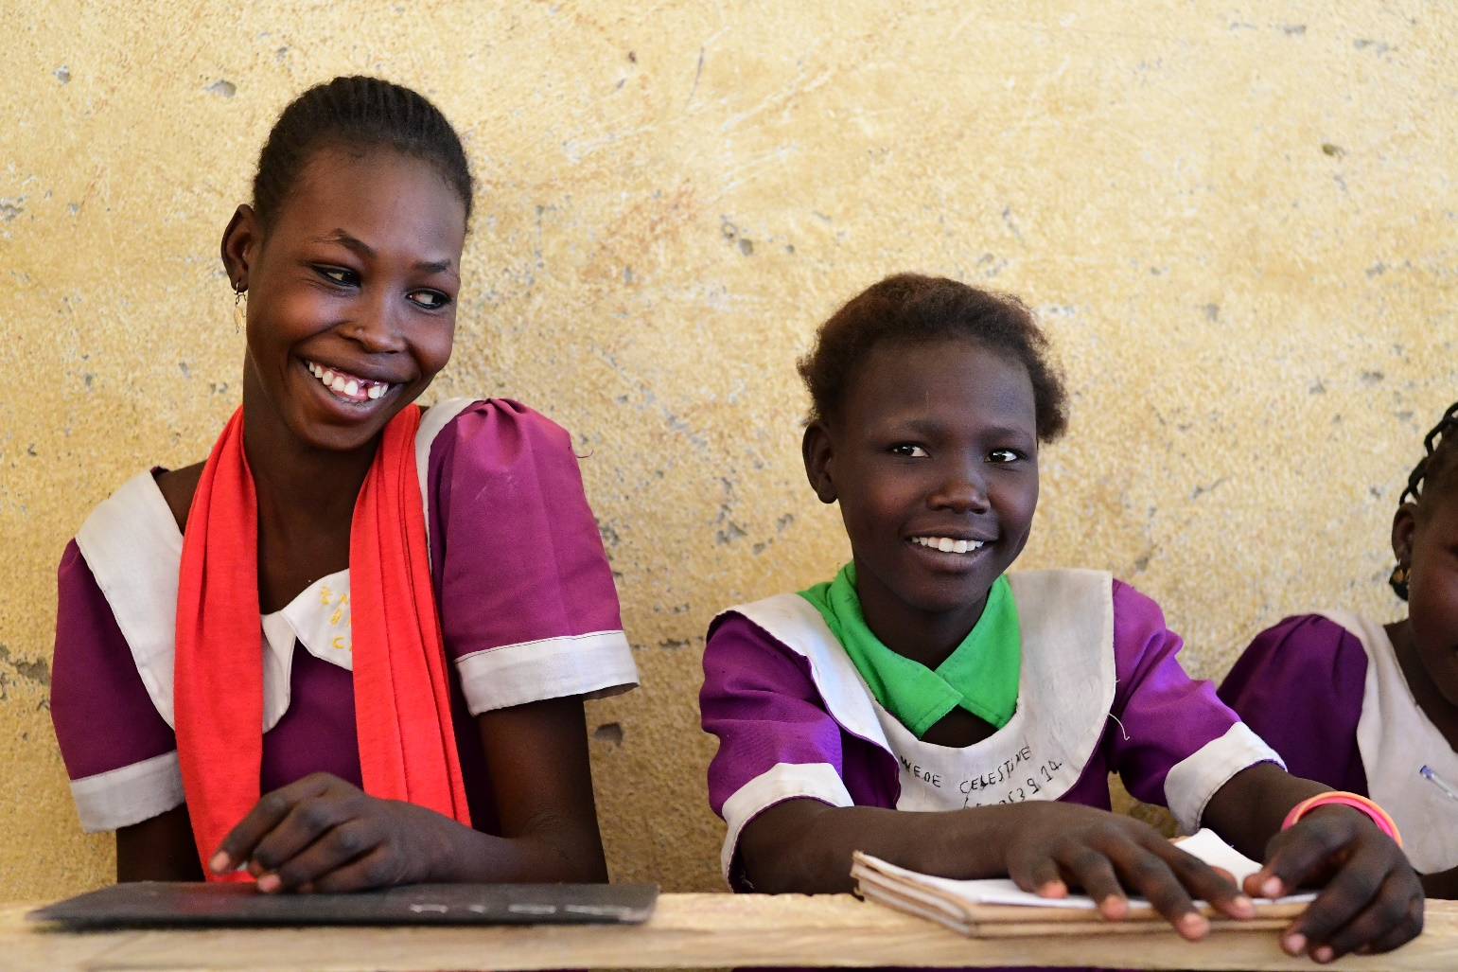
Education for children with disabilities in West and Central Africa
Regional Webinar
Gender and disability inclusion in education: evidence from West and Central Africa

Slide 2

Content of the presentation
1. Objective of the report and link to regional priorities
2. Source of data/information
3. Definition of child functioning
4. Selected results from the report
5. Recommendations

Slide 3
1. Objectives of the report and link to the regional priorities
Bridging the data gaps on CWD: better diagnosis for integration in education sector plans and monitoring systems
Provide regional perspective, both qualitative and quantitative insights on education for children with functional difficulties in West and Central Africa
Strengthen both UNICEF and national ownership of data to support advocacy for CWD during education planning and monitoring process
SDG4 priorities on equitable access to quality education
Provide evidence for improving access to education and reduce the number of CWD that are out of school
  Provide new evidence using Child Functioning Module for the development of inclusive education policies and strategies
  Functional difficulties are part of the parity indicator SDG4.5.1

Slide 4

2. Source of data
Quantitative data analysis focuses on children aged 2 to 17 using MICS 6 survey data, child functioning module
Qualitative data from UNICEF Strategic monitoring questions and UNESCO PEER
Target countries: 9 countries: Central African Republic; Chad; DRC; The Gambia; Ghana; Guinea-Bissau; Sierra Leone; Togo and Sao Tome and Principe

Slide 5
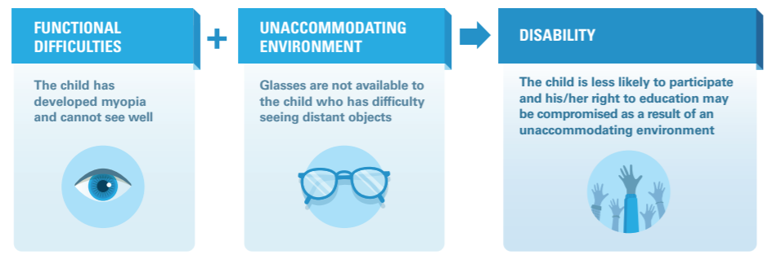
3. Child functioning as measured by UNICEF/WG Child Functioning Module
What is child functioning? What are disabilities?
Source: United Nations Children’s Fund, Do children with disabilities attend school? New findings from Sierra Leone, UNICEF, New York, 2019. Figure 1
Notes:
According to the child functional module, disability arises from an unaccommodating environment. Therefore, the locus is o providing children with tools they need to participate fully in the society.
Above is the example for this, a child has a functional difficulty i.e. myopia and cannot see well but if the child has glasses, this functional difficulty would not result in a disability. The disability arises when the child is not provided with glasses that enable them to see well.

Slide 6
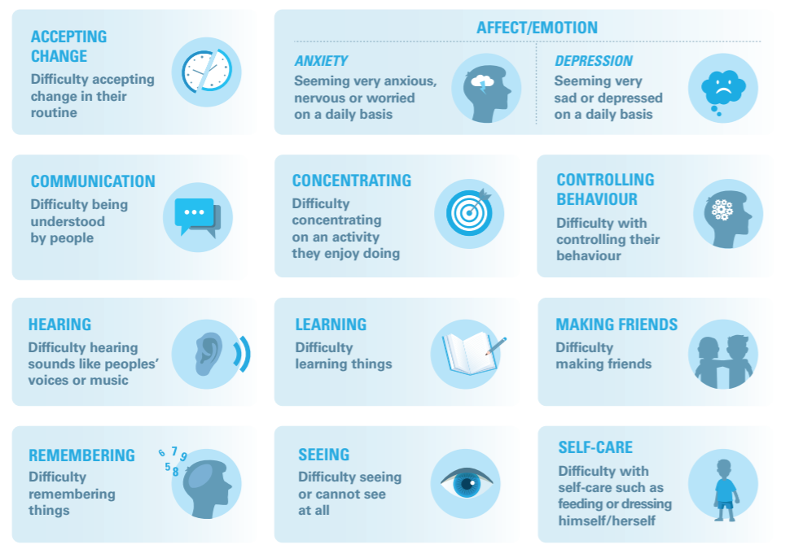
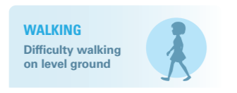
3. Child functioning module: 13 domains of UNICEF/WG module (ages 5-17)
Domains jointly developed by the Washington Group and UNICEF as a global standard to measure functional difficulties of children aged 5 to 17
The domains for children aged 2 to 4 are different
Source: United Nations Children’s Fund, Do children with disabilities attend school? New findings from Sierra Leone, UNICEF, New York, 2019.Figure 2

Slide 7
3. Measuring child functioning
For most domains, children are considered to have functional difficulties if their mother/caretaker respond that they “have a lot of difficulty” in the functional domain or “are not able to perform the function at all”
For anxiety and depression, a child is considered to be anxious or depressed on a daily basis
Children are considered to have functional difficulties if they have difficulty in at least one functional domain

Slide 8
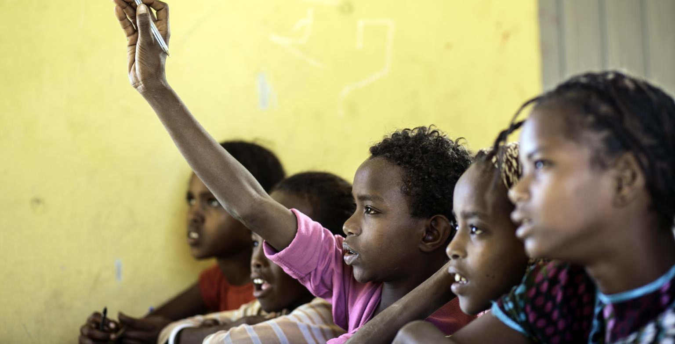
4. Selected results from the report

Slide 9
4.1. Share of children aged 5 to 17 with at least one functional difficulty
Percentage of children with any functional difficulty between 5–17 years varies from 31% in Central African Republic to 10% in the Gambia
Notes:
Remind the audience that these estimations are based on responses by mothers/caretakers and are not based on medical assessment

Slide 10
4.2. Percentage of out of school children and percentage of children attending school at the right age (5-17 years old) in the 9 countries
Children with any or multiple functional difficulties are more likely to be out of school and not attending school at the right age.
Among children with functional difficulties, girls are more likely to attend school at the right age than boys, with no significant gender disparities for being out of school.

Slide 11
4.3. Current school attendance for children aged 5 to 17 years old in the 9 countries
Children aged 5 to 17 with any functional difficulty are less likely to attend school than children without any functional difficulty
Among children with functional difficulty, in relation to the probability to being out of school, there is no significant difference between boys and girls in the attendance rate

Slide 12
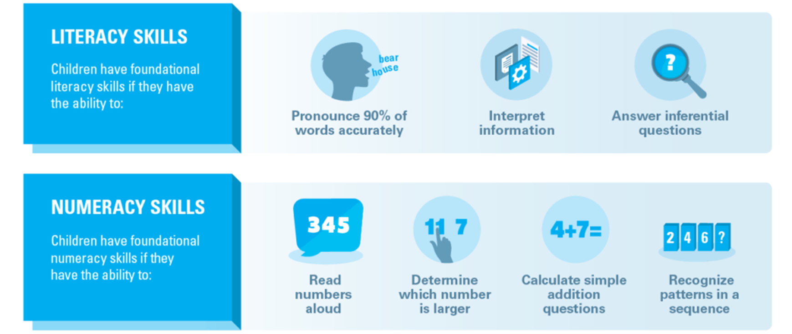
4.4. How are literacy and numeracy skills measured?

Slide 13
4.5. Foundational reading skills expected at grade 2/3 level: (children aged 7 to 14 in and out of school) in the 9 countries
Children aged 7 to 14 with functional difficulties are less likely to have foundational reading skills than children with no functional difficulty
While girls with no functional difficulty perform a little better than boys with no functional difficulty, girls with functional difficulties perform less than boys with functional difficulties

Slide 14
4.6. Foundational numeracy skills expected at grade 2/3 level: (children aged 7 to 14 in and out of school) in the 9 countries
Foundational numeracy skills score are even lower than the reading score for all children, with no significant difference between children with and without functional difficulty
Girls with functional difficulty are again at a disadvantage compared to boys

Slide 15
5. Recommendations
Improve existing Education Management Information Systems (EMIS) to
  collect regular data on children with disabilities/functional difficulties by using harmonized methodology and set of questions and disability disaggregated indicators
  Include information, on school accessibility and teacher’s skills in inclusive education and in identifying students’ functional difficulties
Improve the existing learning outcomes assessment tools by measuring learning achievements for all students including those with disabilities/functional difficulties
Strengthen partnership with health and social services sectors in the early detection of disabilities/functional difficulties and the implementation of early interventions

Slide 16


Final slide. Thank you.
Thank You
© UNICEF/SUDA2014-XX228/Noorani

