Slide 1
To Be a Girl with Disabilities from West Africa
The Educational Situation in Question
Mali, Niger, Burkina Faso

Slide 2
Objective of the study
Objective of the study
➡ To learn how gender, disability, and age shape the experiences of girls with disabilities in terms of school access, retention, and educational achievement.
The results of this study will serve two purposes:
to guide the intervention of HI and its partners in the field of inclusive education
to raise awareness on the importance of developing gender-sensitive inclusive education interventions.

Slide 3
Design of the study
Qualitative, comparative, participative and intersectional approach
Biographical interviews with school-age girls and boys with disabilities.
Participatory observations in special and inclusive schools.
Interviews with institutional actors.
Focus groups with parents, educational actors, religious, community and associative leaders.
Simultaneously, review of critical literature and analysis of existing data.
15 days in each country to conduct the survey, between January and May 2019.
A study assistant was recruited and trained in each of the three countries to facilitate the relations with communities and interviews.

Slide 4
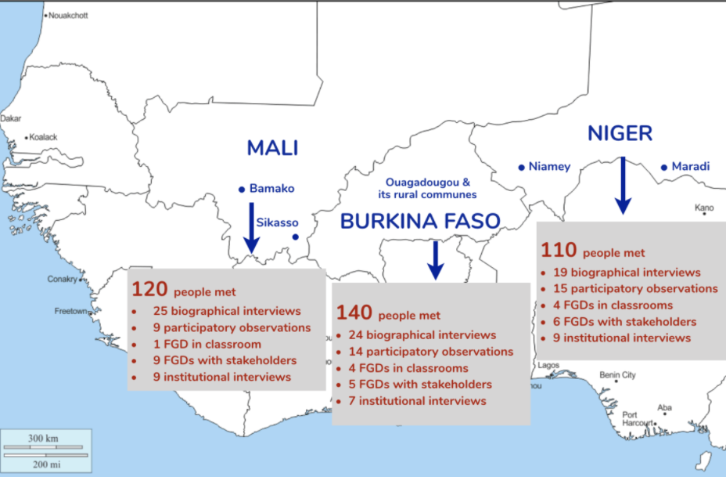
Design of the study (continued)
370 people interviewed
in the 3 countries

Slide 5
Intersectionality & Multiple Discrimination
Gender and Disability
The study provided evidence in the targeted contexts that girls with disabilities face multiple discrimination in education because of their gender and disability.
Negative family and community perceptions and attitudes about disability, coupled with patriarchal norms restricting girls' schooling opportunities, are one of the most significant barriers to education for girls with disabilities.

Slide 6
Influence of Religion and Popular Beliefs
in the Education of Girls with Disabilities
in Mali, Niger and Burkina Faso
Popular beliefs perpetuate stigma and exclusion: Disability as a punishment to the family. Aggravated for severe disabilities and for girls.
Lower enrollment rates of girls with disabilities: families and communities favor the enrollment of boys instead of girls. Education of girls with disabilities is seen as an economic loss.

Slide 7
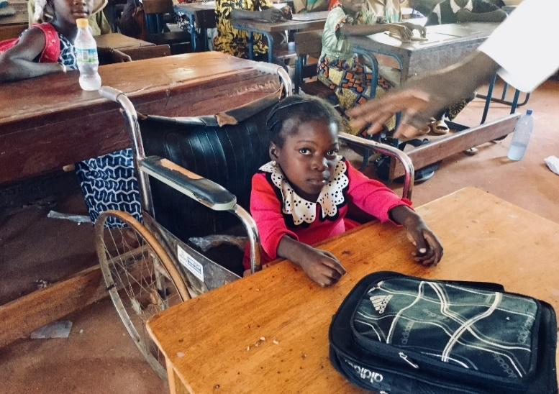
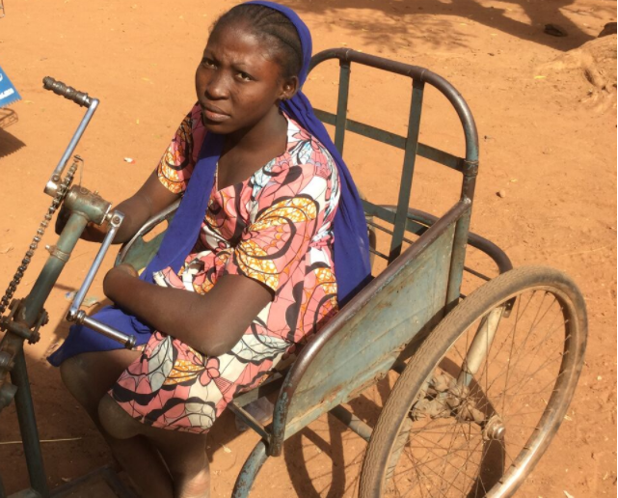
Specific discriminations and aggravating factors
Specific discriminations linked to age: late enrollment of girls. Aggravated school dropout rates due to puberty (domestic work, early marriage, protection issues…).
Specificities linked to the type and degree of disability: children with a physical impairments encounter fewer difficulties for enrollment than those with a moderate or severe intellectual or sensorial impairment.
Impact of socio-cultural and socio-economic factors: A girl with disabilities coming from a family in poverty and/or living in a rural area has less chances to receive education.

Slide 8
Gender-Based Violence and Protection of Girls with Disabilities
“Some people here believe that whoever has sex with a person with intellectual disability and is not caught gets rich.” FGD with religious leaders, Burkina Faso
“Generally, girls with disabilities are given in marriage to marabouts as a kind of alms, without any dowry and without a trousseau being collected”. FGD with DPOs, Niger

Slide 9
Recommendations
For the governments in the Sahel: Explicitly take into account the needs of girls with disabilities in gender policies and in inclusive education programs for children with disabilities, improve disaggregated data collection systems, and collaborate with other interconnected sectors and with civil society.
For donors: adopt an intersectional perspective and a twin-track approach in financing. Increase financing commitments and support civil society organizations, including OPDs.
For civil society organizations: create partnerships between gender-equality and disability movements, advocate and hold decision-makers accountable vis-à-vis their commitments.
For all stakeholders: design awareness-raising strategies and support the empowerment of girls with disabilities.

Slide 10
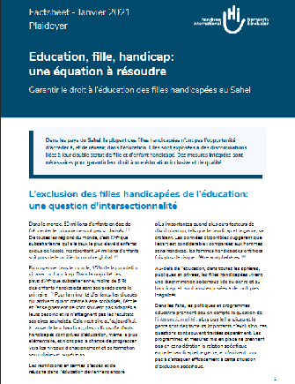
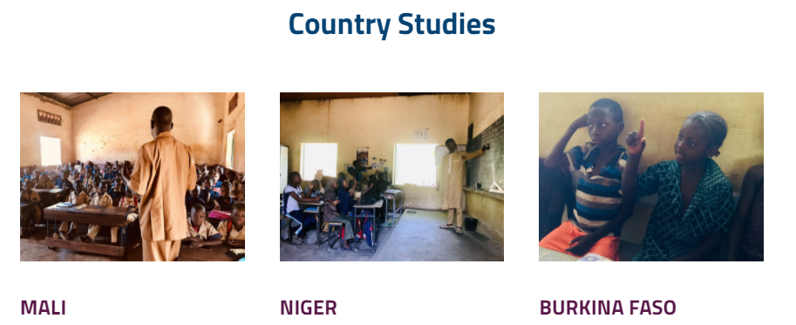
Resources
3 studies (1 per country)
1 summary document
1 advocacy factsheet :
https://blog.hi.org/wp-content/uploads/2021/02/factsheet_2021-GirlsInEducation-EN-review-AB.pdf English
https://blog.hi.org/wp-content/uploads/2021/01/factsheet_2021-FR.pdf French
1 dedicated website:
https://genrehandicapao.hubside.fr/ French
https://genderdisabilitieswa.hubside.fr/ English

